Slide 1


CPSC 462 – Software Design
Chapter 13
Polymorphism
Factory & Abstract Factory Patterns
Professor T. L. Bettens
Spring 2020

Slide 2
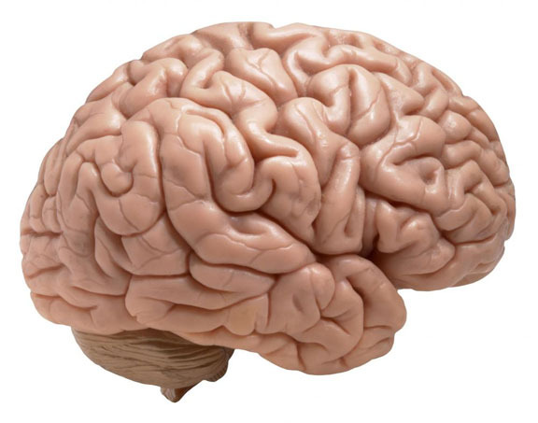
The most important thing you can learn in object-oriented analysis and design
is
skillful responsibility assignment

Slide 3
Definitions Can someone explain Polymorphism to me?
Easiest to start with a non-computer analogy:
Consider if you told somebody to "Go to the store and buy some of your favorite food for supper."
If you said this to a 14 year-old son, he'd probably ride his bike to the store, have to pay cash for the food, and you'd be having pizza for supper.
If you said it to your wife, she'd probably drive to the store, use a card to pay for the food, and you might be eating Chicken Cordon Bleu with Chardonnay instead.
https://stackoverflow.com/questions/7747934/can-someone-explain-polymorphism-to-me

Slide 4
Definitions Can someone explain Polymorphism to me?
In a program, things work out a bit the same way:
You specify something at a relatively abstract level
go to the store and get supper
Each object provides its own concrete implementation of how to implement that, …
… and provides for some variation in exactly what it's going to do
● Bike vs drive ● Cash vs card ● Pizza vs chicken Cordon Bleu with Chardonnay
https://stackoverflow.com/questions/7747934/can-someone-explain-polymorphism-to-me

Slide 5
Definitions Can someone explain Polymorphism to me?
In a program, things work out a bit the same way:
You specify something at a relatively abstract level (go to the store and get supper)
Each object provides its own concrete implementation of how to implement that, …
… and in many cases provides for some variation in exactly what it's going to do
The differences in favorite foods above
Of course, when you're programming, most of that requires a specification that's a lot more detailed and unambiguous. The general idea remains the same though. For the scenario above, you might have a person base class (or interface) that defined methods like go to store and select favorite food and pay for purchase. You'd then have implementations of that like adult and teenager, each of which defined its own method of going to the store, selecting favorite food, and paying for a purchase. Those methods would be polymorphic, because each implementation would have its own way of carrying out the higher-level command you gave.
https://stackoverflow.com/questions/7747934/can-someone-explain-polymorphism-to-me

Slide 6
Definitions Can someone explain Polymorphism to me?
Friendship – one word, many meanings
A boy starts LOVE with the word FRIENDSHIP but
A girl ends LOVE with the same word FRIENDSHIP
Word is the same, but functionality is different. That's polymorphism
https://stackoverflow.com/questions/210460/try-to-describe-polymorphism-as-easy-as-you-can

Slide 7
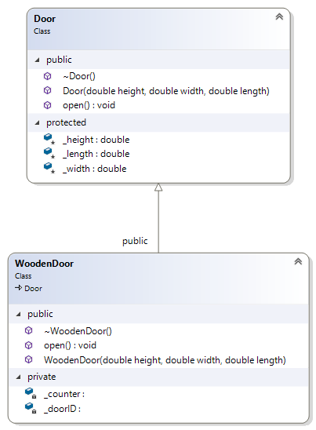
Has-a vs Is-a
HAS-A
IS-A
Door “has-a”:
Height, length, width
WoodenDoor “has-a”
Height, length, width
Counter, doorID
WoodenDoor “is-a”
Door

Slide 8
In Class Activity
1) The naive approach
Download, compile, and run “main - don't do this getSupper.cpp”
Add another kind of person, say a college student, that
Has food delivered, pays by ApplePay, and eats Ramen Noodles
Be sure to have each person (not just the one you added) doSomething in function main()
Compile and run
Again, add another kind of person, this time your choice
Repeat above steps

Slide 9
In Class Activity
2) The Simple approach
Repeat step 1 with “main - simple getSupper.cpp”
3) The One Better approach
Repeat step 1 with “main - self registering getSupper.cpp”

